Slide 1
Your Logo Here
Event Title
Date

Slide 2
Made in Florida
www.madeinflorida.org
Great careers are waiting for you!!
MADE IN FLORIDA ~ MADE IN FLORIDA ~ MADE IN FLORIDA ~ MADE IN FLORIDA

Slide 3
Manufacturing Jobs on Indeed
Notes:
Our History starting as an NSF ATE Regional Center

Slide 4
Manufacturing
Great Careers
Great Futures
Great Lifestyle
Why not YOU?
MADE IN FLORIDA ~ MADE IN FLORIDA ~ MADE IN FLORIDA ~ MADE IN FLORIDA
Notes:
Talking Points:
The manufacturing industry is a great place to find your future and future lifestyle. Manufacturing is at the cutting edge of most technologies – implementing change and innovation nearly everyday. Its stimulating; its fun; its rewarding. You can grow a great career in this industry no matter where you start.

Slide 5
Great Careers
  Over 427,500 people
  in over 26,000 companies
  in Florida
  are making lots of things
  every day.
MADE IN FLORIDA ~ MADE IN FLORIDA ~ MADE IN FLORIDA ~ MADE IN FLORIDA

Slide 6
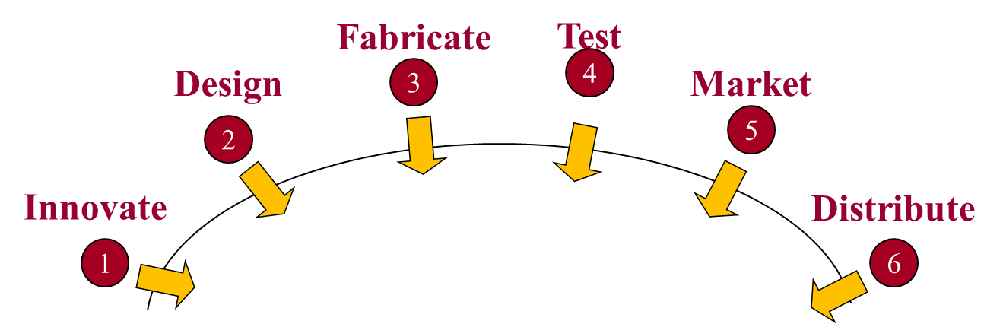
Great Careers!
It’s time for you to think about your future!
sample jobs
Product designer
Production process
Production 0perators
Equipment technicians
Process technicians
Materials handling
Logistics technicians
Quality technicians
Information technology
Technical Sales
Additive manufacturing technician
Inspection technicians
Packaging Design
Robotics Technician
Lots more!
Notes:
Talking points
The 380,000+ Floridians who currently work in the field of manufacturing support any one or many of these phases: acting on new ideas or opportunities; designing new products or processes to build the products; fabricating them; testing for quality; marketing and selling the products; or getting the products to their final consumers.
There are many professional opportunities and high-wage jobs in the field of manufacturing. Every year, hundreds of positions remain unfilled throughout the State.
Anyone you know who works for a manufacturer?

Slide 7









Do what you
Manufacturing Careers in all these Sectors
Aviation & Aeronautics
Medical Devices & Equipment
Electronics & Electrical
Food & Beverage
Transportation Logistics
Machining & Product Fabrication
Product Design & System Integration
Leisure & Entertainment
Others
MADE IN FLORIDA ~ MADE IN FLORIDA ~ MADE IN FLORIDA ~ MADE IN FLORIDA
Notes:
Talking points:
MANUFACTURING SECTORS allow for everyone to work on products or processes that they love.
NOTE: There are a lot of ways to categorize manufacturing companies – here is one we have used.
Categories are arbitrary and many companies choose to focus on a category that meets their own needs.
The idea is to give the audience a good view of the breadth of manufacturing.

Slide 8





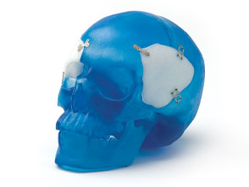



Do what you
Piper Aircraft
Vero Beach
Zimmer Biomet Jacksonville
Siemens
Boca Raton
Signature Brands
Ocala
Notes:
Talking points
Introduce examples of different manufacturing sectors. You should certainly focus on your local or regional companies and sectors.
The examples provided are illustrative only, not comprehensive. They include the following:
Aviation and aeronautics includes all the supporting technologies around the space industry and real-size flight simulators for commercial and combat airplanes.
Biological and medical manufacturing includes products in biotechnology, medical instrumentation and supplies.
Electronic devices includes products like bar code readers and printers, finger print readers and gyroscopes used by helicopters.
Food, paper, beverages & cosmetics includes many products ranging from cookies, soaps, lipstick, soda, juice, processed foods and many more.

Slide 9




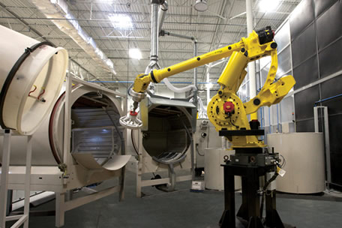
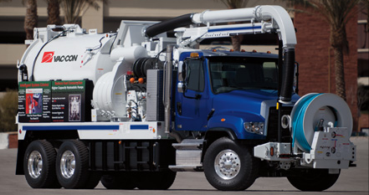


Do what you
Vac-Con
Green Cove Springs
Chromally
Tampa
Leonardo DRS
Melbourne, Ft. Walton Beach
Black Diamond Strings
Sarasota
Notes:
Talking points
Introduce examples of different manufacturing sectors. You should certainly focus on your local or regional companies and sectors.
The examples provided are illustrative only, not comprehensive. They include the following:
Transportation includes vehicles including ships, trains, cars and bikes, warehousing and inventory control and global logistics.
Machining & Product fabrication includes finished products or components for other products, such as landing gears and canopies for combat airplanes to hydraulic valves and doorframes for automobiles.
Product Design & System Integration includes computer hardware, networks and even power plant simulators
Leisure and entertainment includes animatronics, park rides, sports simulations, video games, multimedia.

Slide 10
Great Futures
  High skill, high wage and in-demand jobs keep the average wage of people working in manufacturing in Florida at over $61,000/year.
WHY NOT YOU?
MADE IN FLORIDA ~ MADE IN FLORIDA ~ MADE IN FLORIDA ~ MADE IN FLORIDA

Slide 11


Great lifestyles..
Jobs that require a high school diploma/GED, on-the-job training, work experience.
Now
SAMPLE ENTRY LEVEL JOBS | HOURLY WAGE
Inspector, Tester, Sorter, Operator | $24.00
Machinist | $25.63
Electrical & Electronic Equipment Assembler | $19.44
Assemblers & Fabricators | $19.09
Annual Salary
$39,000-$53,000*
* Plus benefits (e.g., vacation, health insurance, etc.).
good jobs + great pay = GREAT LIFESTLYE!
Notes:
Talking points:
These are sample job titles drawn for Department of Labor, Workforce Florida and companies. They are only typical job titles and vary from company to company.
There is a downloadable handout with this information called “Job Journey” that FLATE has prepared located at: http://madeinflorida.org/careers/

Slide 12

Great lifestyles..
Next
Jobs that require 2-4 years of education beyond high school.
SAMPLE ENTRY LEVEL JOBS | HOURLY WAGE
Electrical/Electronic Engineering Technician | $33.77
Drafter | $30.57
Mechanical Engineering Technician | $31.89
Aerospace Engineering Technician | $40.68
Engineering Technician | $34.82
Annual Salary
$57,000-$72,000*
* Plus benefits (e.g., vacation, health insurance, etc.).
good jobs + great pay = GREAT LIFESTLYE!
Notes:
Talking points:
These are sample job titles drawn for Department of Labor, Workforce Florida and companies. They are only typical job titles and vary from company to company.
There is a downloadable handout with this information called “Job Journey” that FLATE has prepared located at: http://madeinflorida.org/careers/

Slide 13
Great lifestyles..
Jobs that require 4 or more years of education beyond high school + work experience
Later
SAMPLE ENTRY LEVEL JOBS | HOURLY WAGE
Materials Engineer | $52.86
Electronics Engineer | $57.90
Electrical Engineer | $54,22
Mechanical Engineer | $48.98
Annual Salary
$101,000-$120,000*
* Plus benefits (e.g., vacation, health insurance, etc.).
good jobs + great pay = GREAT LIFESTLYE!

Slide 14
Great fun!
Do you get excited about …
making things and taking them apart?
thinking about how to make products better?
using new technologies and software?
working with others in teams?
testing new ideas?
Then the manufacturing industry may be the right place for you!
MADE IN FLORIDA ~ MADE IN FLORIDA ~ MADE IN FLORIDA ~ MADE IN FLORIDA
Notes:
Talking Points
Here are some of the characteristics of people who like working in manufacturing. Engage the audience/students in thinking about how they would answer this question – if positively, then manufacturing could be right for them.

Slide 15
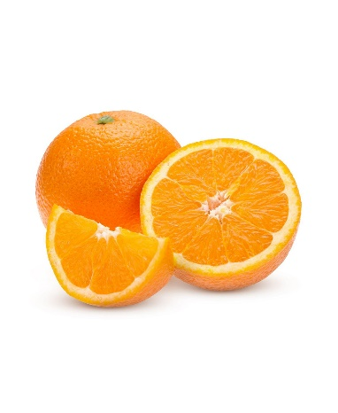
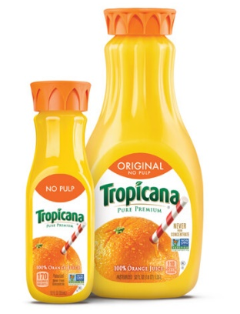
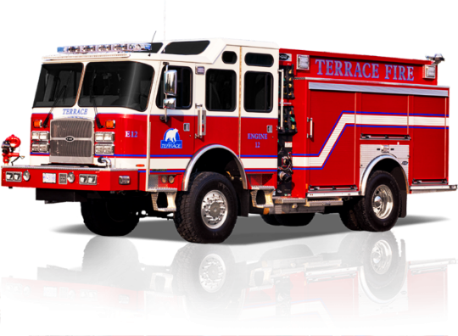
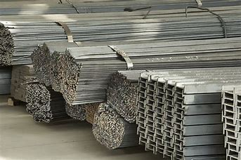
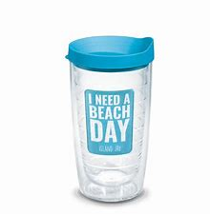
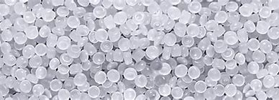
What is manufacturing?
  It’s the magic of changing materials
  into products that people can use.
Including products that you use!
MADE IN FLORIDA ~ MADE IN FLORIDA ~ MADE IN FLORIDA ~ MADE IN FLORIDA
Notes:
The world of manufacturing is all around us.
Almost everything we use in our daily lives has been created and manufactured by someone else.
Make reference to manufactured objects in the room, from desks and chairs to lamps, windows, carpets, books and clothing.
Two broad areas you might start with are materials and process.
Why is this item made from ____?
How do you think someone makes this shape?
The big picture – raw materials are transformed into Products. Metal Stock is used to make fire trucks and plastic pellets make cups.
The next slide goes into a manufacturing process (specific design process for manufacturing but derived from a typical engineering design process).

Slide 16
What is manufacturing?
Making something.
Making a lot of them.
Make money on your products.
MADE IN FLORIDA ~ MADE IN FLORIDA ~ MADE IN FLORIDA ~ MADE IN FLORIDA
Notes:
The basics of business of manufacturing

Slide 17
How it happens
Fabricate
Test
Design
3
4
Market
2
5
Innovate
Distribute
1
Product
6
www.madeinflorida.org
Notes:
Talking points on the manufacturing process
Product designed and developed (innovation), Raw materials identified, Raw materials transported to manufacturing site
Materials are processed in multiple steps to transform it to product, Product is packaged (on site or different site) and marketed
Product is transported to distribution centers, Product is sold
The manufacturing process is a very dynamic process and all the phases or components may influence one another. Distribution might come last and, in many cases, may not affect the design process. But if the product needed to be delivered to a space station, all other aspects of the manufacturing cycle (the design, the materials, the manufacturing process, etc.) would be affected by the “last” step, distribution.

Slide 18
The Manufacturing Cycle
Innovate
Respond to a market need or invent a new product to solve a problem.
Design
Try your ideas about what to make, how it will look and feel, how it will perform and how it could be made.
Fabricate
It takes skills, technology and teamwork turn ideas into real products that meet the product criteria.
Test
Quality is important. Everything is tested to be sure they perform as designed.
Market
Products need to be offered to potential consumers.
Distribute
Packaging and distributing products is a logistics puzzle.
Notes:
Inform participants that there are many business support functions in the manufacturing industry, as well as many opportunities to be promoted within the different departments that support the manufacturing cycles.
The design process takes the initial concept and transforms it into a working model.
Making ideas a reality requires engineering, computer assisted drawing, prototyping and selection or invention of the tools and processes that will be used to manufacture the designed product.
Quality is important for any manufactured product.
All parts need to be made according to the design and all products need to be tested before they are assembled and sent to customers.
In this examples, (left image) a technician inspects the actual dimensions of a component of the barcode printer. Another technician (right image) tests dozens of printers at a time to insure that they work properly and flawlessly over extended periods of time.
After much hard work that is required in creating the ideas and making them happen, manufacturers still need to promote their products and ideas to potential customers.
The business, sales and marketing efforts of a manufacturing firm as important as its other functions.
Customer support is often included in this aspect of the operation.
Talking points for distribution
Packing, shipping and distribution are the final components of the manufacturing process.
Products need to be transported by air, land or sea to the hands of its final consumers.
These same transportation networks might be used to deliver the raw materials or components to the manufacturing pant.
There are many supporting industries to the entire field of manufacturing, each providing opportunities and jobs to many more individuals.
Package engineers and technicians optimize how a product is packaged, how much volume it occupies, how much protecting packaging is needed and what materials are used.

Slide 19
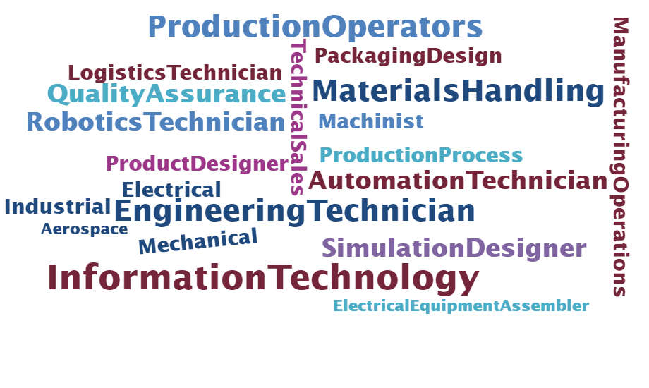
Do what you
MADE IN FLORIDA ~ MADE IN FLORIDA ~ MADE IN FLORIDA ~ MADE IN FLORIDA

Slide 20


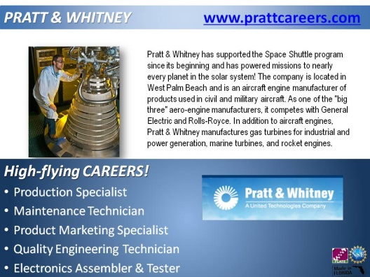



Where are the jobs?
almost anywhere..
Cool companies make very cool things right here in Florida!
Notes:
This page links to the Made in Florida page that has several company profiles. These can be viewed online as a slide show or popped as individual slides/images for review. If you would like your company promoted here, please contact Desh Bagley, FLATE outreach manager (outreach@fl-ate.org).
PAGE LINK: http://madeinflorida.org/company-profiles/

Slide 21





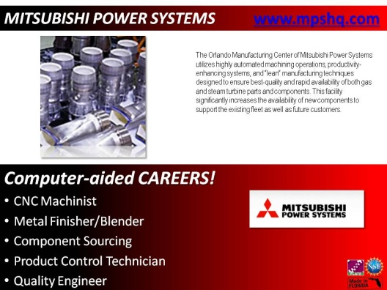
Where are the jobs?
almost anywhere..
Cool companies make very cool things right here in Florida!
Notes:
This page links to the Made in Florida page that has several company profiles [CAN BE PERSONALIZED TO A SPECIFIC COMPANY OR REGION – Contact events@flate.org if assistance is needed]. These can be viewed online as a slide show or popped as individual slides/images for review. If you would like your company promoted here, please contact Desh Bagley, FLATE outreach manager (outreach@fl-ate.org).
PAGE LINK: http://madeinflorida.org/company-profiles/

Slide 22
How do you get there?
It’s time for you to think about your future!
Middle School
-----------------
Prerequisites
Community College
College/ University
and/or
High School
-------------------
Career Track | Academic Track
Certificate
AS/AAS Degree
BAS/BA/BS
Master/PhD
Training/
Certification
Manufacturing Careers
Notes:
Talking points for educational and career pathways
There are different ways to enter the world of modern manufacturing.
Employers offer many opportunities to learn on-the-job while attending high school, a technical school, community college or university.
Recommendations
Depending on the audience, explore in-depth the many points of entry into manufacturing. Consider that many employers are willing to provide on-the-job training for entry-level positions, encourage work-study programs and offer tuition reimbursement for existing employees.
There might be as many opportunities to get into the field of manufacturing as there are to going back to school or being promoted within.
Inside most manufacturing operations there are, at least, three different clusters of jobs and careers: (1) those related to the actual manufacturing of goods; (2) those providing support and maintenance to the manufacturing equipment and technology and (3) those supporting the business operations. They all serve as points of entry and promotion into and within a company.

Slide 23
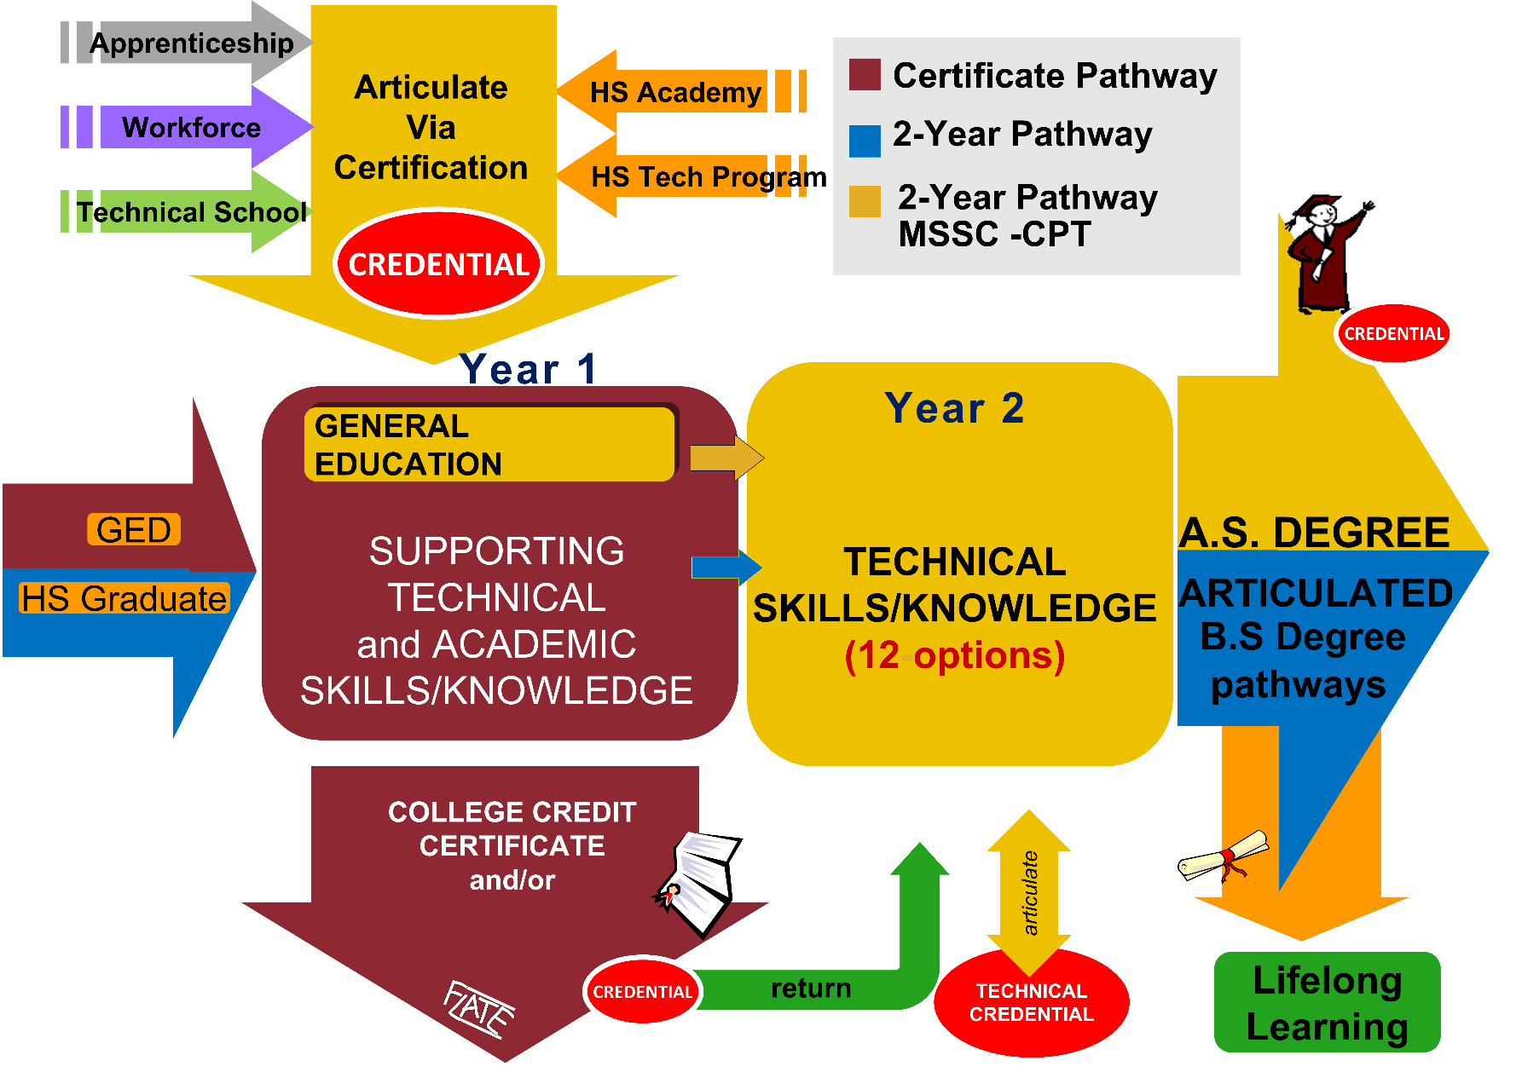
Get Started
Engineering Technology (ET) Education Pathways
Notes:
The Engineering Technology Degree pathway links to the Made in Florida webpage that has links to all schools and programs for ET in Florida, and additional resources about MSSC certification.
Link: http://madeinflorida.org/engineering-technology-degree/e-t-overview/
Page Link 2: http://www.fl-ate.org/projects/degree-reform.html

Slide 24
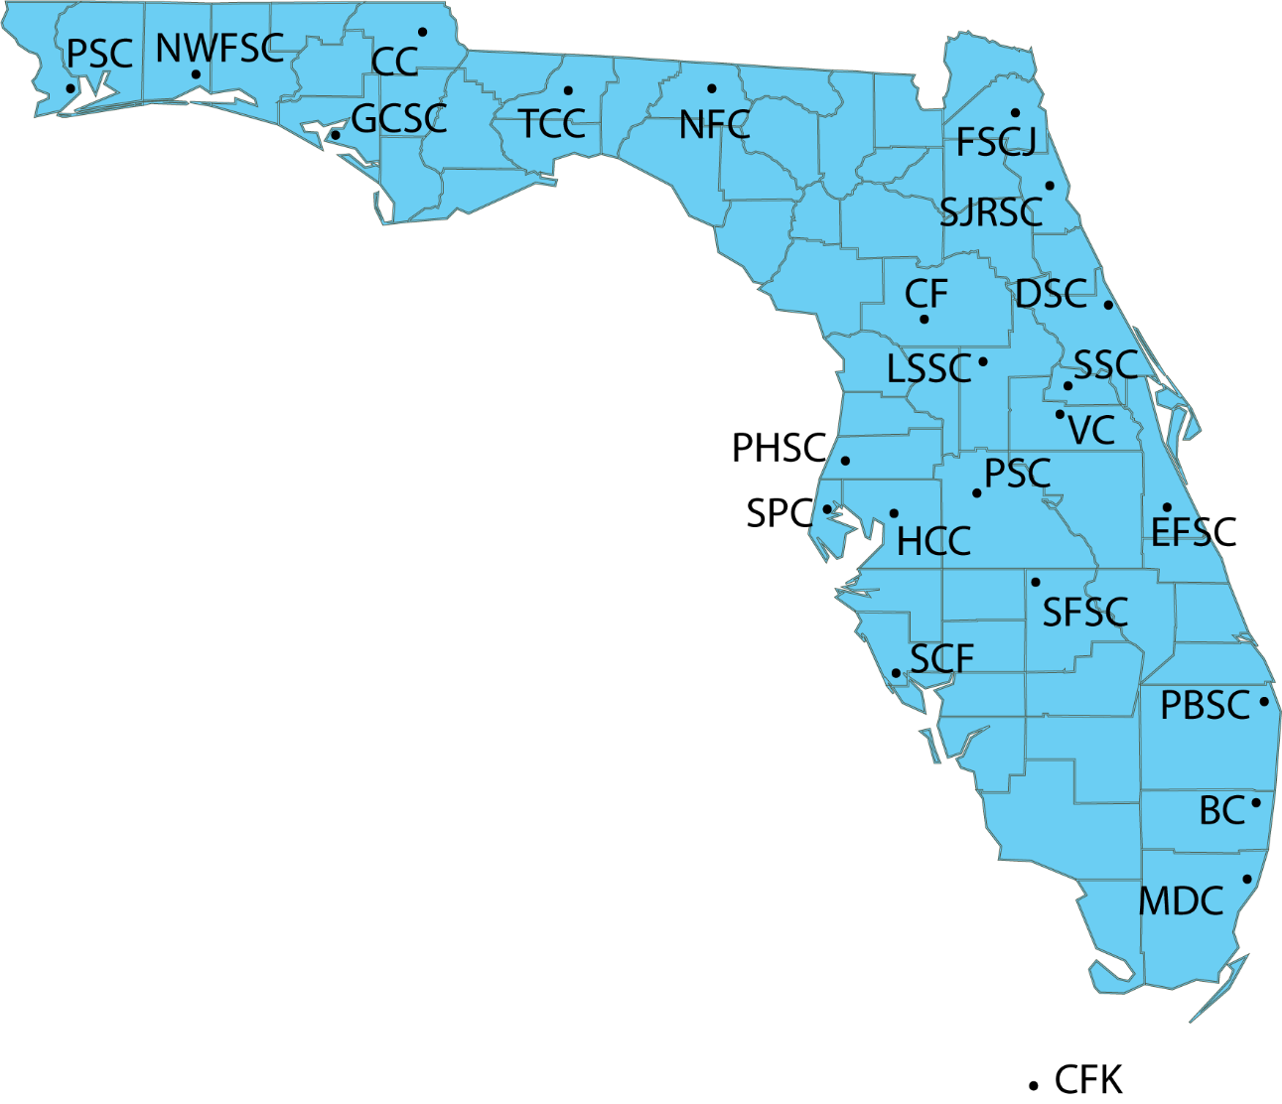
Earn and Learn
State and Community Colleges that offer the Engineering Technology A.S. Degree & thousands of manufacturers all over Florida are waiting for you!
Broward College (BC)
College of Central Florida (CF)
Chipola College (CC)
Daytona State College (DSC)
Eastern Florida State College (EFSC)
College of the Florida Keys (CFK)
Eastern Florida State College (EFSC)
Florida State College at Jacksonville (FSCJ)
Gulf Coast State College (GCSC)
Hillsborough Community College (HCC)
Lake Sumter State College (LSSC)
Miami Dade College (MDC)
North Florida College (NFC)
Northwest Florida State College (NWFSC)
Palm Beach State College (PBSC)
Pasco Hernando State College (PHSC)
Pensacola State College (PSC)
Polk State College (PSC)
Seminole State College (SSC)
St. Johns River State College (SJRSC)
St. Petersburg College (SPC)
South Florida State College (SFSC)
State College of Florida (SCF)
Tallahassee Community College (TCC)
Valencia College (VC)
Notes:
This map shows 2014 Manufacturers in Florida and the state and community colleges that offer the AS Degree in Engineering Technology. Each blue dot is one company). Also, ET schools are identified.

Slide 25

Learn more..
Notes:
RESOURCES on MADE IN FLORIDA
You can find more information on www.madeinflorida.org. [You can click on it to open the website in its own window if you have internet access]. The PowerPoint will still be open behind the browser window, so you can continue the slide show after visiting the website.

Slide 26
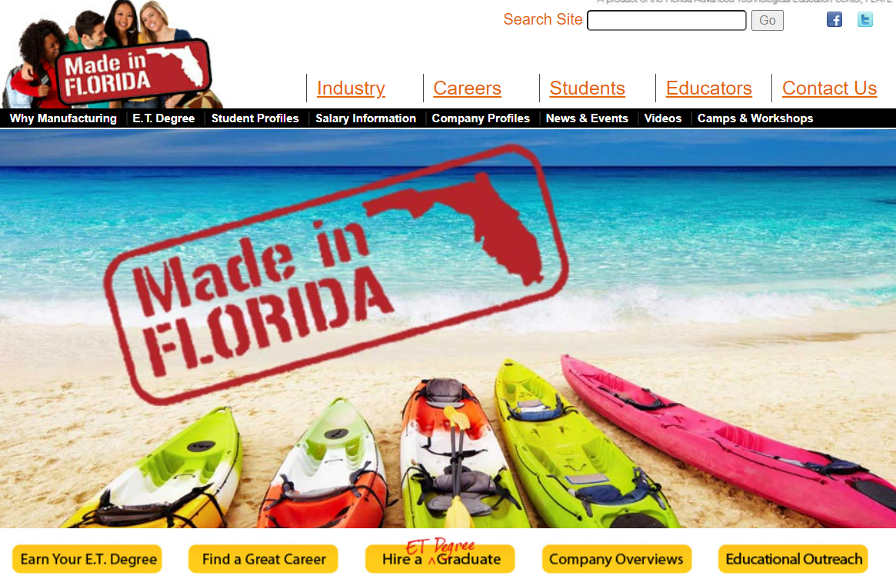
Learn more..
Career Pathways | Company Profiles | Virtual Tours
Notes:
RESOURCES on MADE IN FLORIDA
MadeinFlorida.org has information on Manufacturing Careers.
Click on Careers for links to Career opportunities, company profiles and virtual tours of Florida manufacturers.

Slide 27
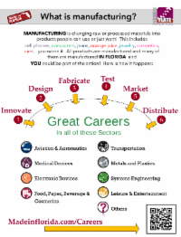
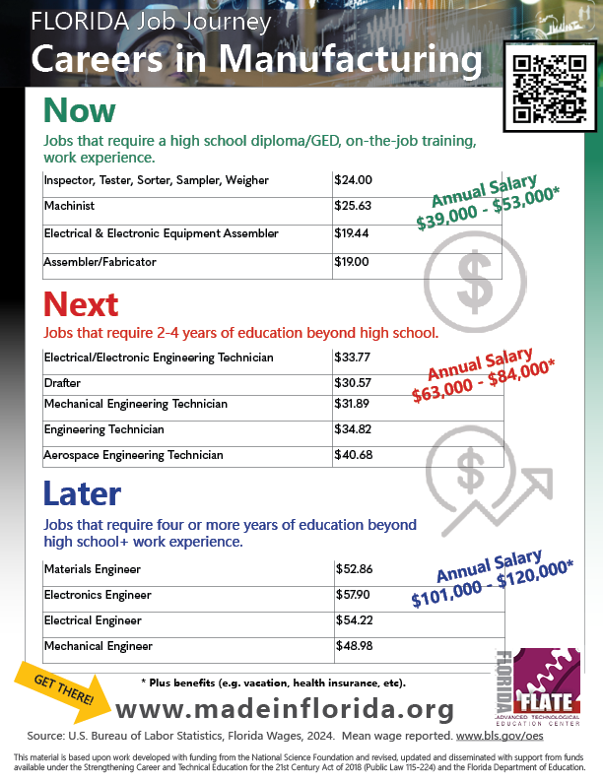
Learn more..
Career Options| ET Degree Programs| Salary Information
Notes:
RESOURCES on MADE IN FLORIDA

Slide 28

Any Questions?
Thank you!
Contact FLATE at events@flate.org.
MADE IN FLORIDA ~ MADE IN FLORIDA ~ MADE IN FLORIDA ~ MADE IN FLORIDA

